Slide 1
Duna Mozi Frontend
Készítette: Czinege Zoltán

Slide 2
The purpose of the project
Simple and quick access to the cinema's offer
General information about movies
Simple and fast ticket reservation

Slide 3
Functions of the webpage
Average user functions:
Search among movies
Ticket booking
View Events and Film Screenings
Admin and employee functions
User Management (Only for Admin user)
Film, Film Screening and Event Management
Login

Slide 4
The Webpage
Frontend
Html
CSS
JavaScript
Bootstrap
Backend
NodeJS
REST API
Authentication
Database
MySql

Slide 5
Database
MySQL
Model First
Loading Data
Admin and employee user
Movies
Movie categories
Tickets
Screening rooms
Procedures: 32
Tables: 10

Slide 6
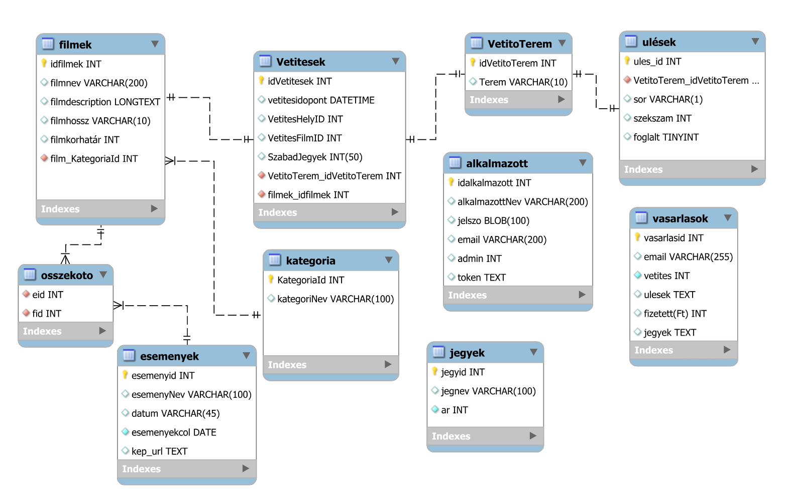

Slide 7
Work of Zoltán Czinege
Design
Bootstrep
Css
date format
Layout
Regex
Cypress tests
documentation

Slide 8
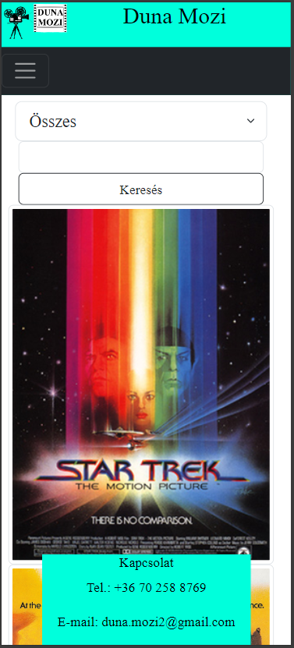
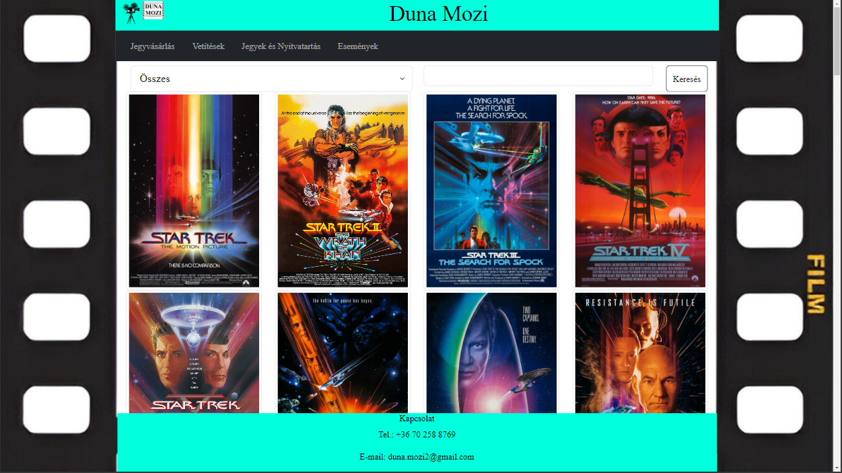
Responsivity
Available for mobile
Desktop
Mobile

Slide 9
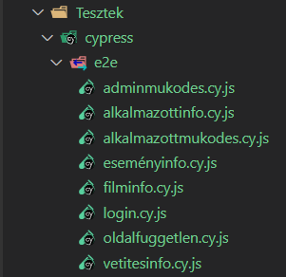
Tests
Frontend
Cypress
Test quantity: 80

Slide 10
Teamwork
GitHub
Microsoft Teams
Client Software and Server Software developing
Progressing through smaller projects, not by files
Clean code

Slide 11
Future plans
English added for internationality
Changing the division of the pop-up window that appears when clicking on the movie poster to the one designed in Figma, in the interest of increasing transparency.
Replace the error message alert with something nicer.

